Slide 1
Chapter 16
Waves (I) Halliday/Resnick/walker

Slide 2
Key content
Define waves
Types of waves
Mechanical waves
Sinusoidal waves
Characteristics of waves
Superposition principle

Slide 3
16.1 Types of Waves
Mechanical waves
Electromagnetic waves
Gravitational waves
Matter waves
Waves are propagating ‘disturbance’ without matter transportation, but energy and momentum are transported.

Slide 4
Define waves
Waves are propagating ‘disturbance’ without matter transportation, but energy and momentum are transported.
There are different types of waves like
Mechanical waves, EMT waves, Matter waves, Gravitational waves

Slide 5
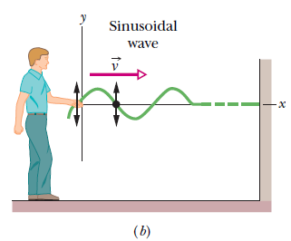
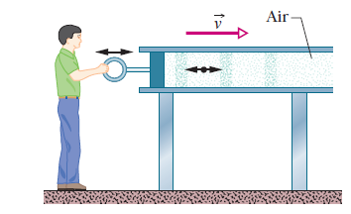
16.1 Types of Waves
In a transverse wave, the displacement of every such oscillating element along the wave is perpendicular to the direction of travel of the wave, as indicated in Fig. 16-1.
# EM waves in vacuum are also called transverse waves, because the direction of fields is perpendicular to the propagation direction.
In a longitudinal wave the motion of
the oscillating particles is parallel to the direction of the wave’s travel, as shown in Fig. 16-2.
# In this chapter, we will focus on transverse mechanical waves.

Slide 6
Mechanical Wave Requirements
Some source of disturbance
A medium containing elements that can be disturbed
Some physical mechanism through which elements of the medium can influence each other
Section 16.1

Slide 7
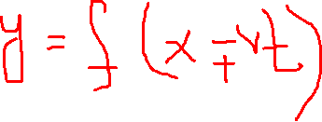
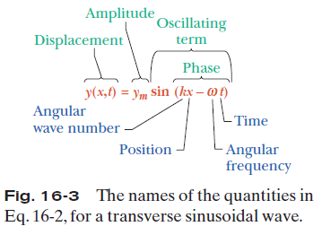
16.2 Wave Variables

Slide 8




16.2 Wave Variables
The amplitude y_{m} of a wave is the magnitude of the maximum displacement of the elements from their equilibrium positions as the
wave passes through them.
The phase of the wave is the argument (kx –ωt) of the sine function. As the wave sweeps through a string element at a particular position x, the phase changes linearly with time t.
The wavelength λ of a wave is the distance parallel to the direction of the wave’s
travel between repetitions of the shape of the wave (or wave shape). It is related to the angular wave number, k, by
:
The period of oscillation T of a wave is the time for an element to move through one full oscillation. It is related to the angular frequency, ω, by
The frequency f of a wave is defined as 1/T and is related to the angular frequency ω by
A phase constant φ in the wave function:
y =y_{m} sin(kx –ωt+ φ). The value of φ can be chosen so that the function gives some other displacement and slope at x = 0 when t = 0.

Slide 9
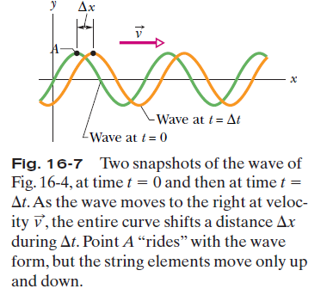

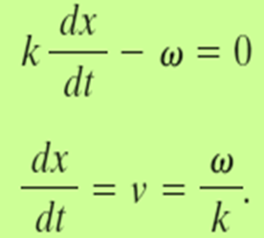
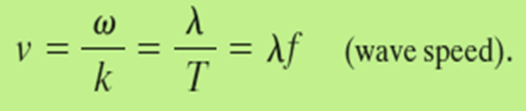
16.3 The Speed of a Traveling Wave

Slide 10
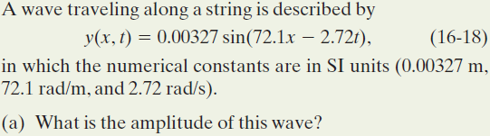
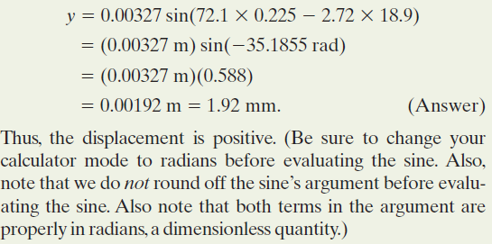
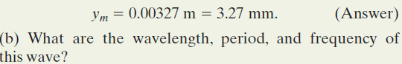
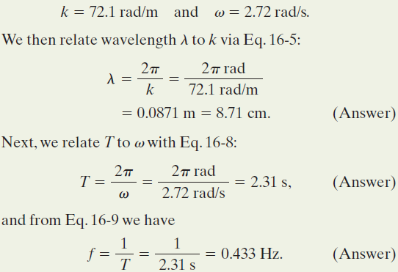

Example, Transverse Wave

Slide 11
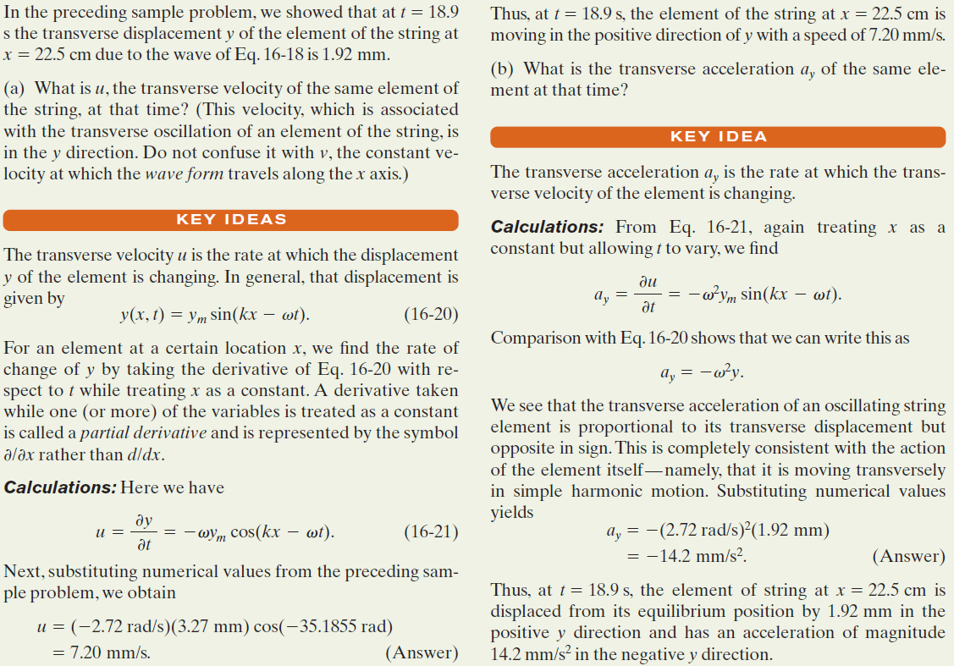
Example, Transverse Wave, Transverse Velocity, and Acceleration

Slide 12
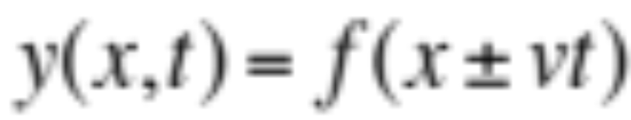
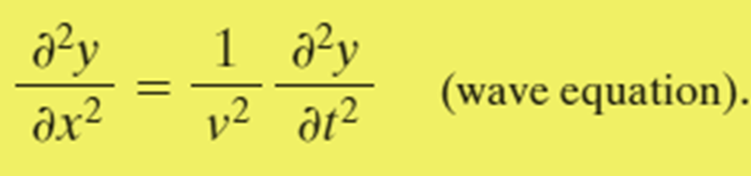
16.6 The Wave Equation
A travelling wave is always in the following form:
Such functions are solutions of the wave equation:
# It is a linear partial differential equation; when y₁ and y₂ are solutions, any linear combination of y₁ and y₂ (like ay₁+by₂) is also a solution.

Slide 13
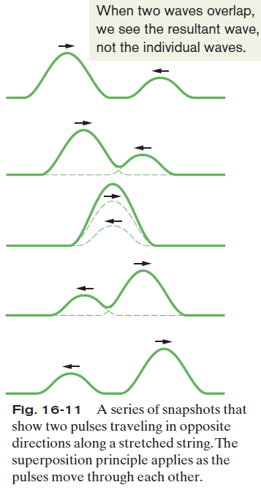

16.7 The Superposition of Waves
Overlapping waves algebraically add to produce a resultant wave (or net wave).
Overlapping waves do not in any way alter the travel of each other.
They interfere but do not interact.
# The principle of linear superposition is valid only when the amplitude is small.

Slide 14



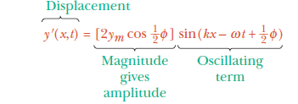
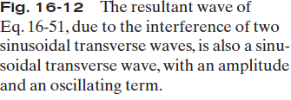
16.8 Interference of Waves
If two sinusoidal waves of the same amplitude and wavelength travel in the same direction along a stretched string, they interfere to produce a resultant sinusoidal wave traveling in that direction.

Slide 15
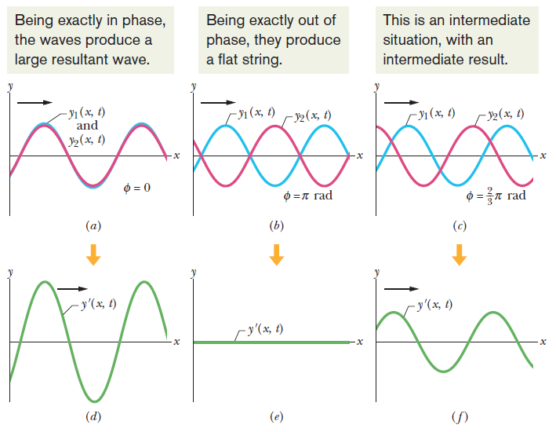
16.8 Interference of Waves

Slide 16
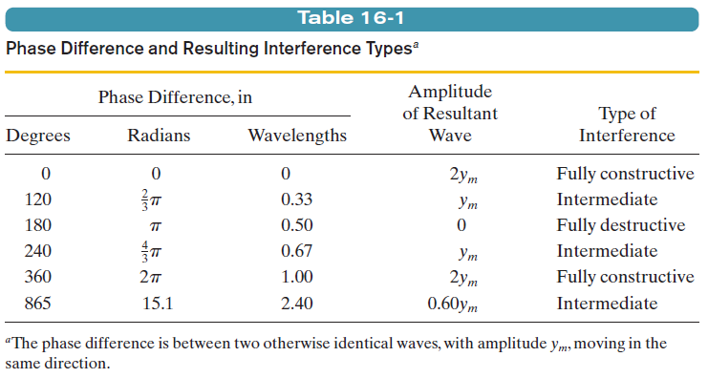
16.8 Interference of Waves

Slide 17
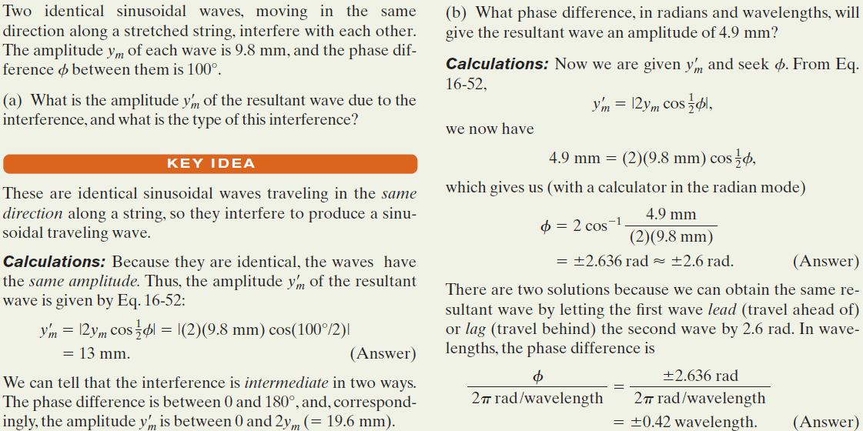
Example, Transverse Wave:

Slide 18
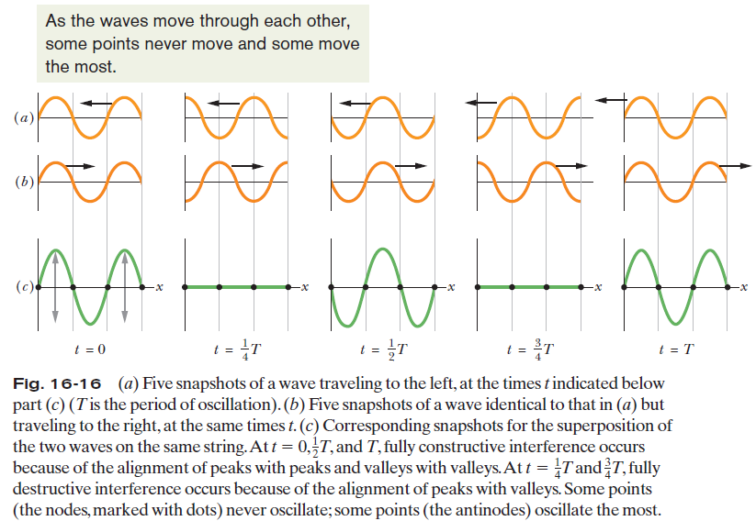
16.9: Standing Waves

Slide 19

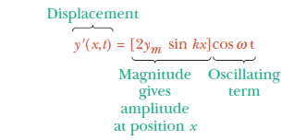
16.9: Standing Waves
If two sinusoidal waves of the same amplitude and wavelength travel in opposite directions along a stretched string, their interference with each other produces a standing wave.

Slide 20
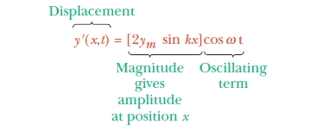
16.9: Standing Waves
The amplitude is zero when kx =nπ, for n =0,1,2, . . . .
Since k =2π/λ, we get x = n λ/2, for n =0,1,2, . . . (nodes),
as the positions of zero amplitude or the nodes.
The amplitude has a maximum value of 2y_{m} when
kx = 1/2π, 3/2π, 5/2π, . . .=(n+1/2) π, for n =0,1,2, . . . .
That is, x = (n+1/2) λ/2, for n 0,1,2, . . . (antinodes),
as the positions of maximum amplitude or the antinodes.

Slide 21
Problem solving
Super position principle

Slide 22
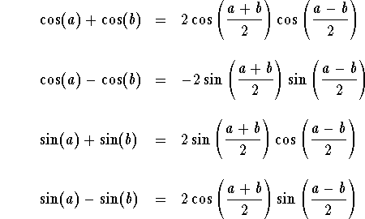
Formulas to be used

Slide 23
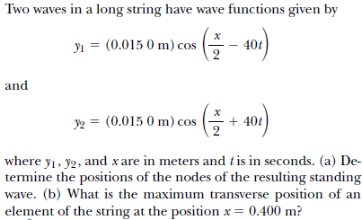
Problem 1

Slide 24
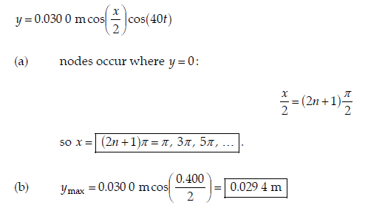
Solution problem 1

Slide 25
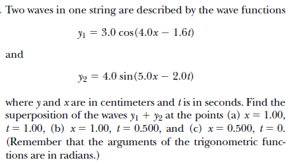
Problem 2

Slide 26
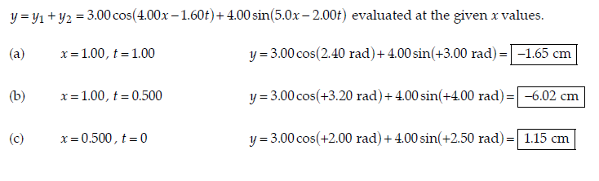
Solution problem 2

Slide 27
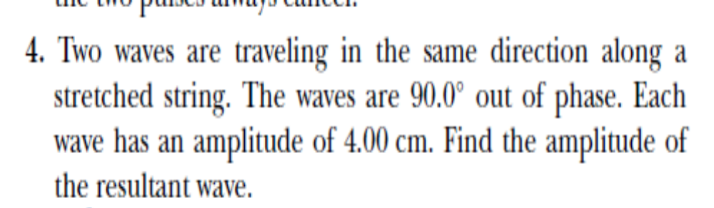
Problem 3

Slide 28
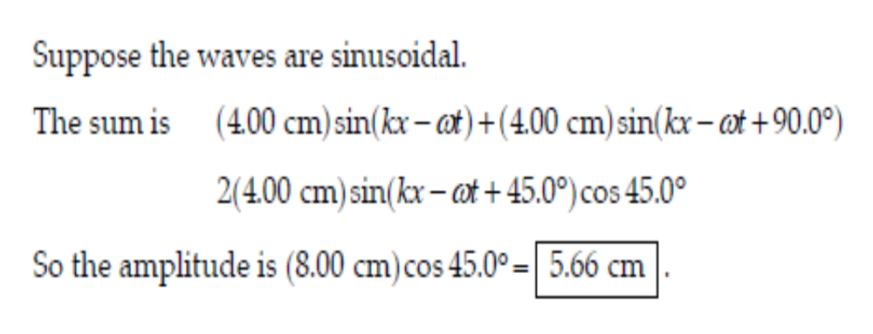
Solution problem 3

Slide 29
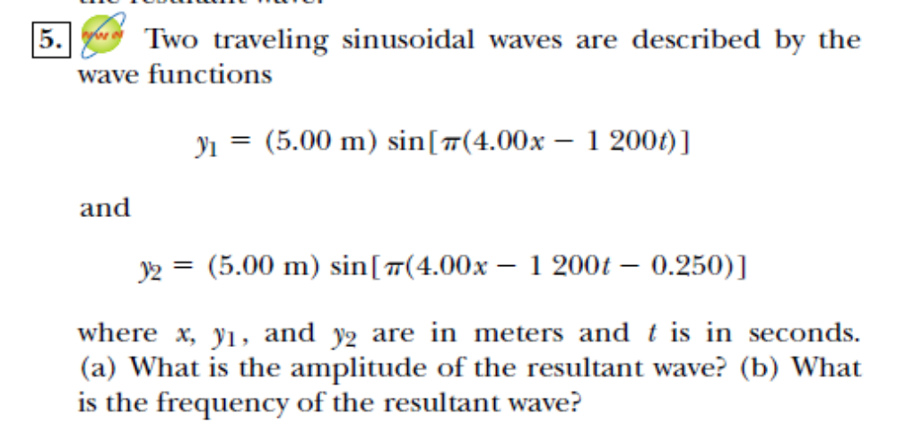
Problem 4

Slide 30
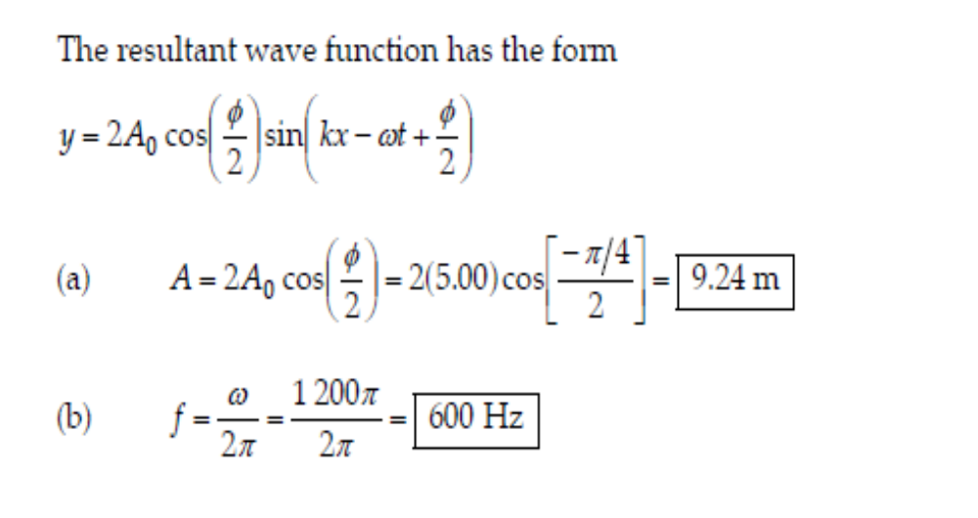
Solution problem4

Slide 31
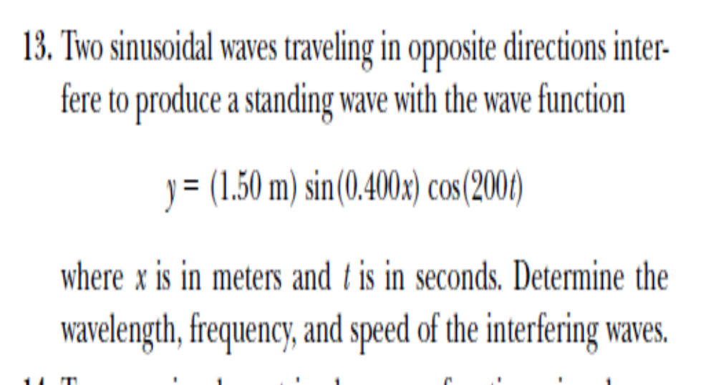

Problem 5

Slide 32
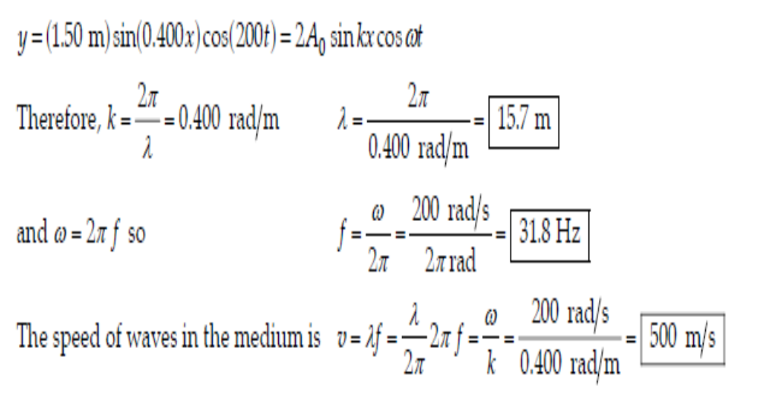
Solution problem5

Slide 33
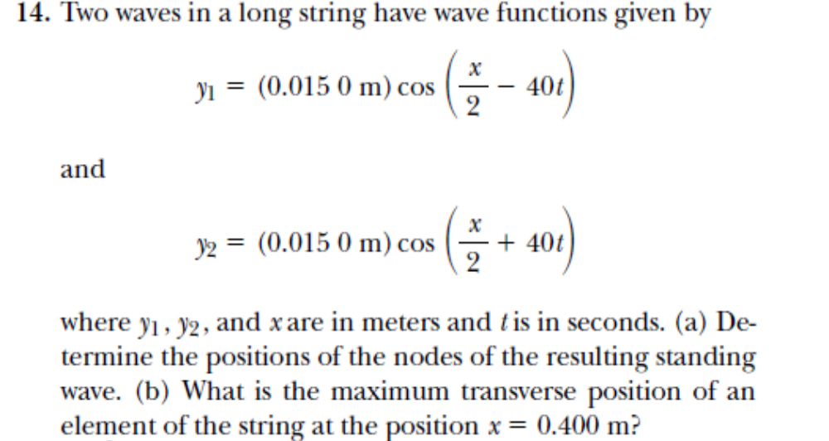
Problem 6

Slide 34
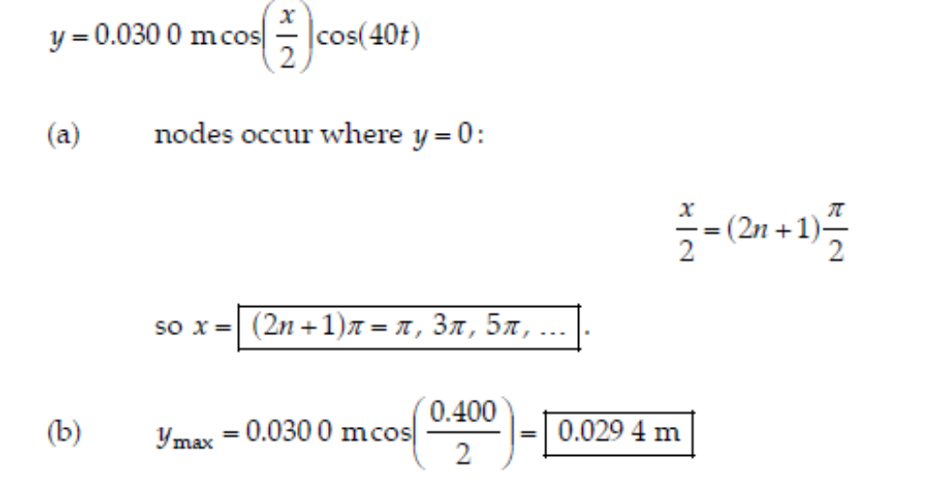
Solution problem 6

